Slide 1
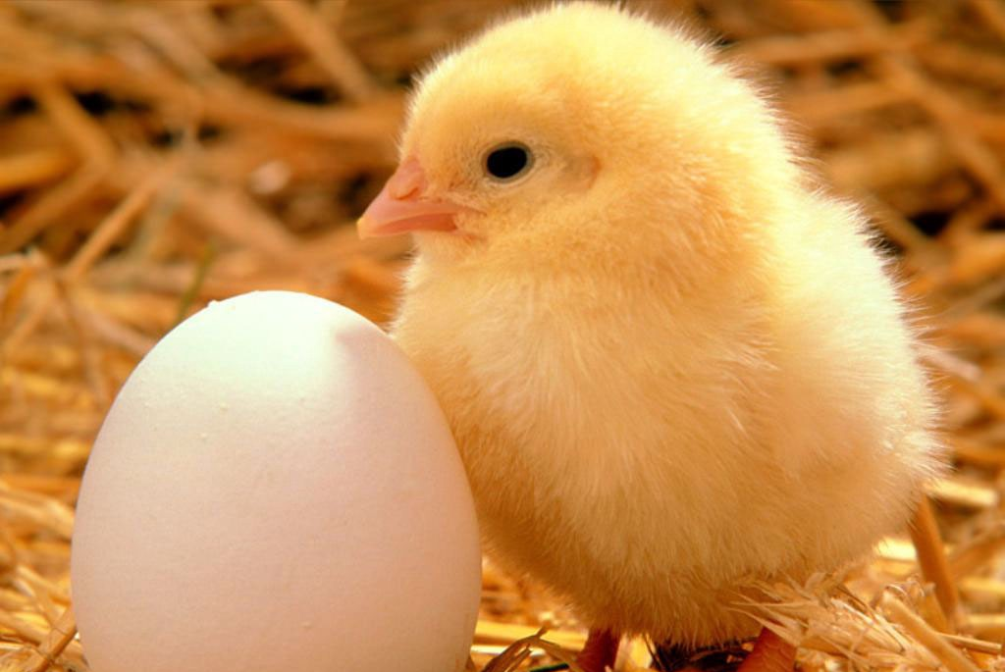
Caring for Chickens

Slide 2
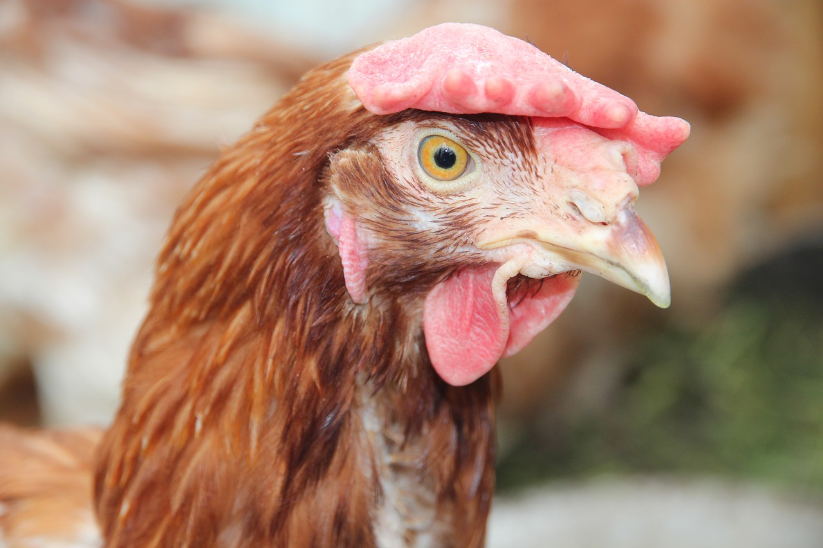
Vocabulary Draw a line from the word to the correct definition
Hatchery
Pullets
Hen
Rooster
Poultry Farm
Brooding
A young hen
A place for hatching eggs
To sit on eggs in order to hatch them
A female chicken
A place where domesticated birds are raised
A male chicken

Slide 3
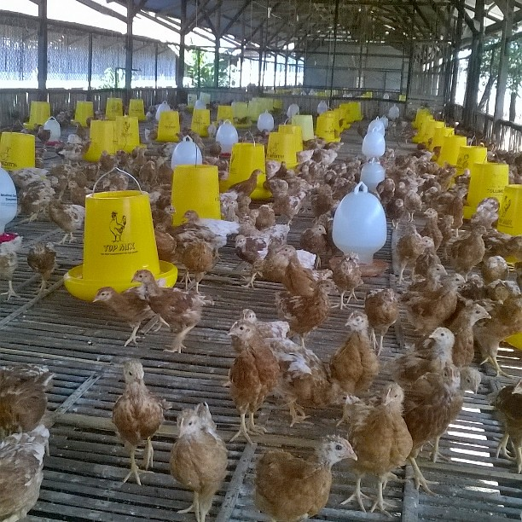
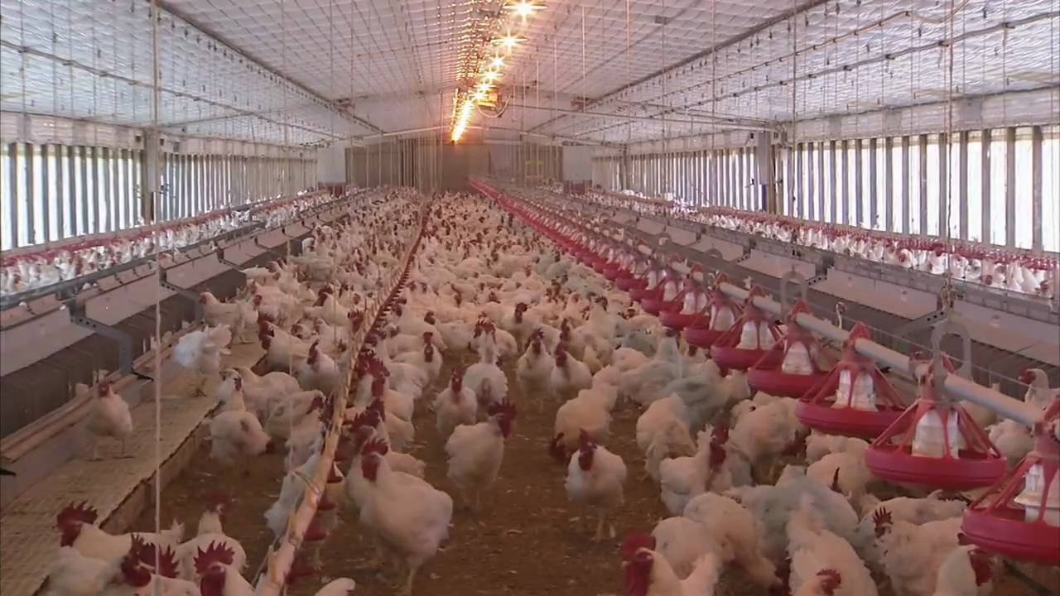
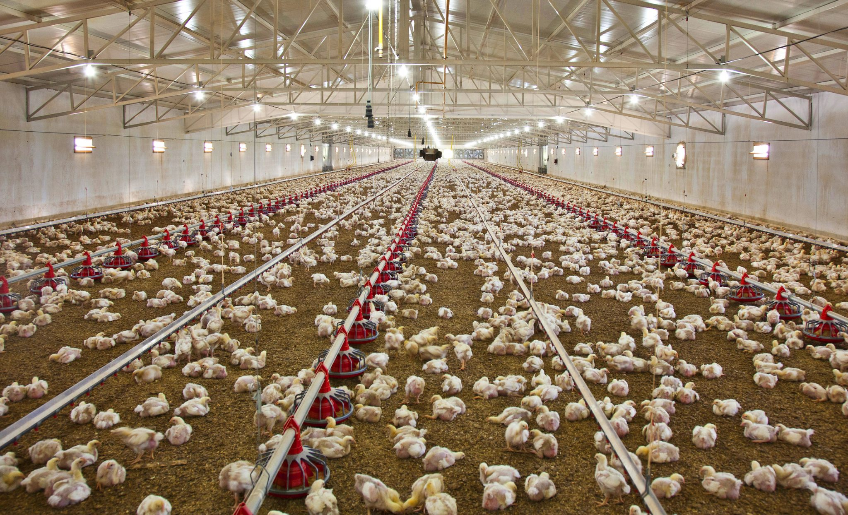
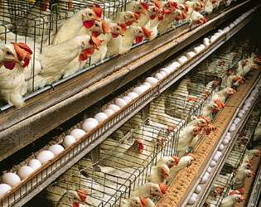
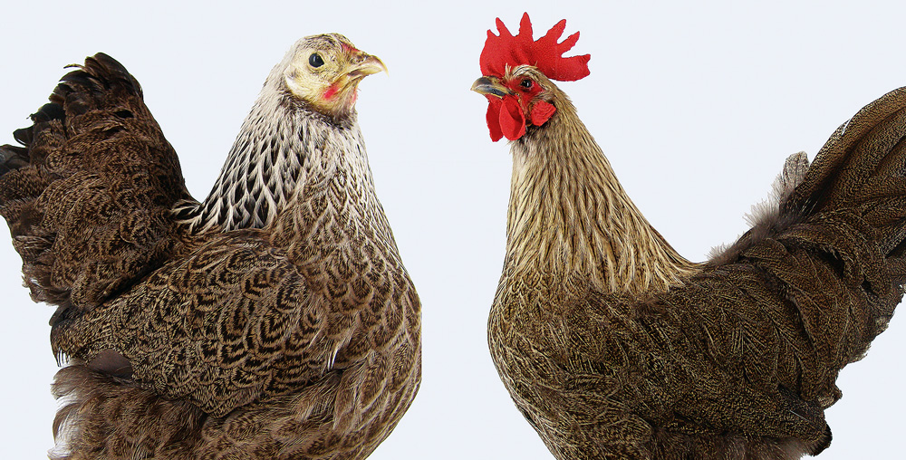
Types of Chicken Farms
Pullet Farm
Breeder Farm
Broiler Farm
Laying Farm
Hackle Farm

Slide 4
Pullet Farm
Raises pullets (a young hen) or roosters.
Chicks stay at this farm until they are 20-22 weeks old.
Once they 20-22 weeks old they go to a breeder farm where they will lay eggs.
Least common type of poultry farm

Slide 5
Breeder Farm
Roosters and hens mate to fertilize eggs.
Chickens find a nest to lay fertilized eggs.
Eggs are collected and sorted.
Eggs are taken to the hatchery.
Chickens are kept on this farm for 43-46 weeks.
Hopefully 85-90% of eggs that have been fertilized will hatch.

Slide 6
Broiler Farm
Chickens are harvested for meat
Baby chicks are brought to the farm at 1 day of age
Kept for 5-9 weeks
Chickens grow to be 2.5-8lbs
Sold to consumers, grocery stores, restaurants, etc.
Most common type of poultry farm

Slide 7
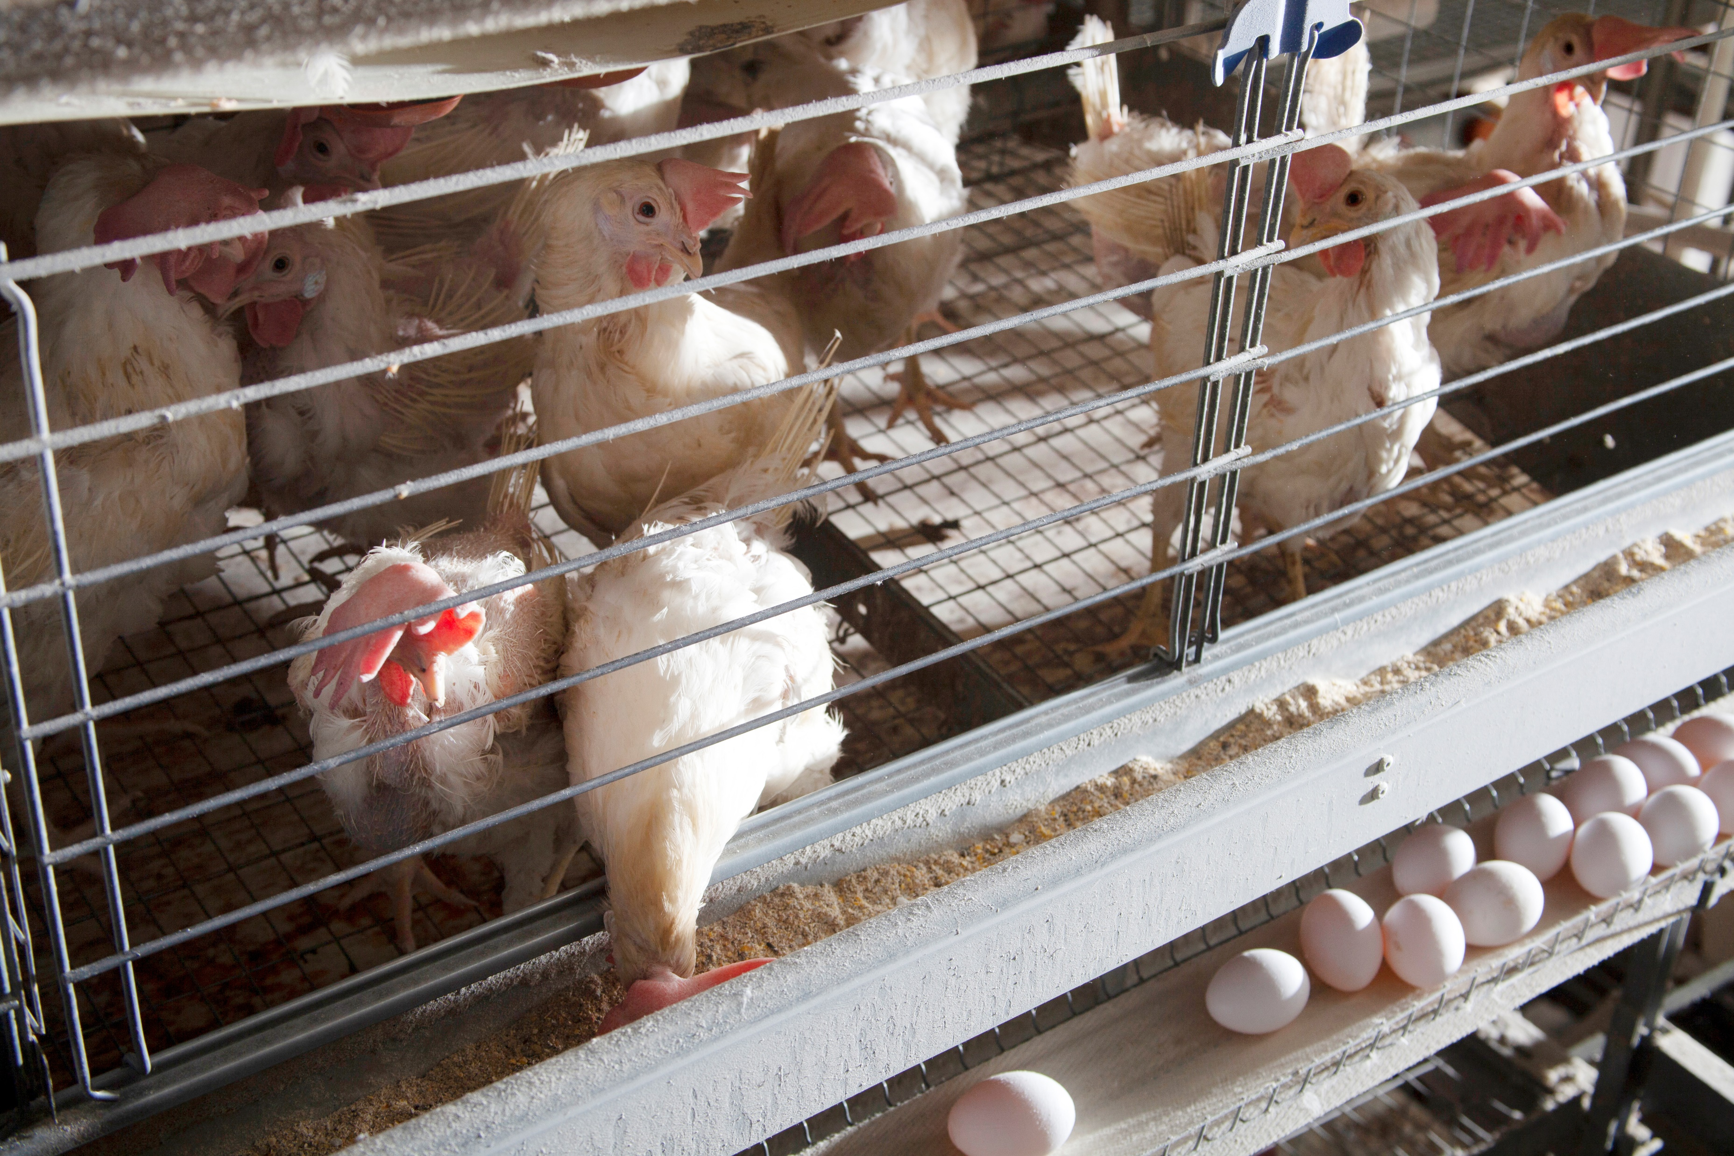
Laying Farm
Chickens are raised specifically for laying eggs
Farmers pick the best breed of chicken for laying eggs
Chickens can produce about 275 eggs/year
Chickens naturally live 6+ years
After 1-2 years of laying productivity may decline

Slide 8
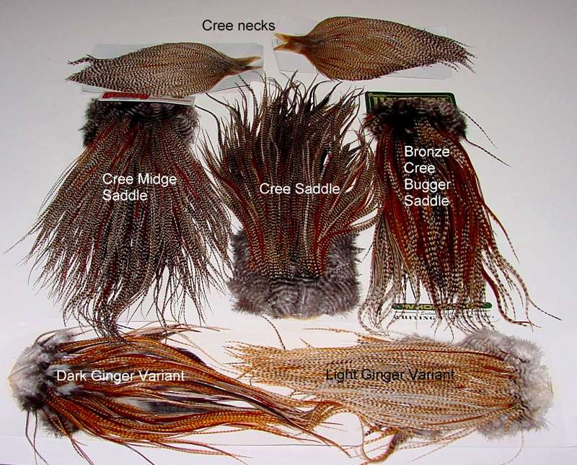
Hackle Farm
Chickens raised for their feathers.
Hackle: Long narrow feathers on the neck or saddle of a bird.
Artificial fishing fly made mainly of neck feathers.

